Slide 1
Overview of Skills4EOSC
outcomes and resources
20 September 2024
Nana Anastasopoulou, GRNET
T8.2 Task leader

Slide 2
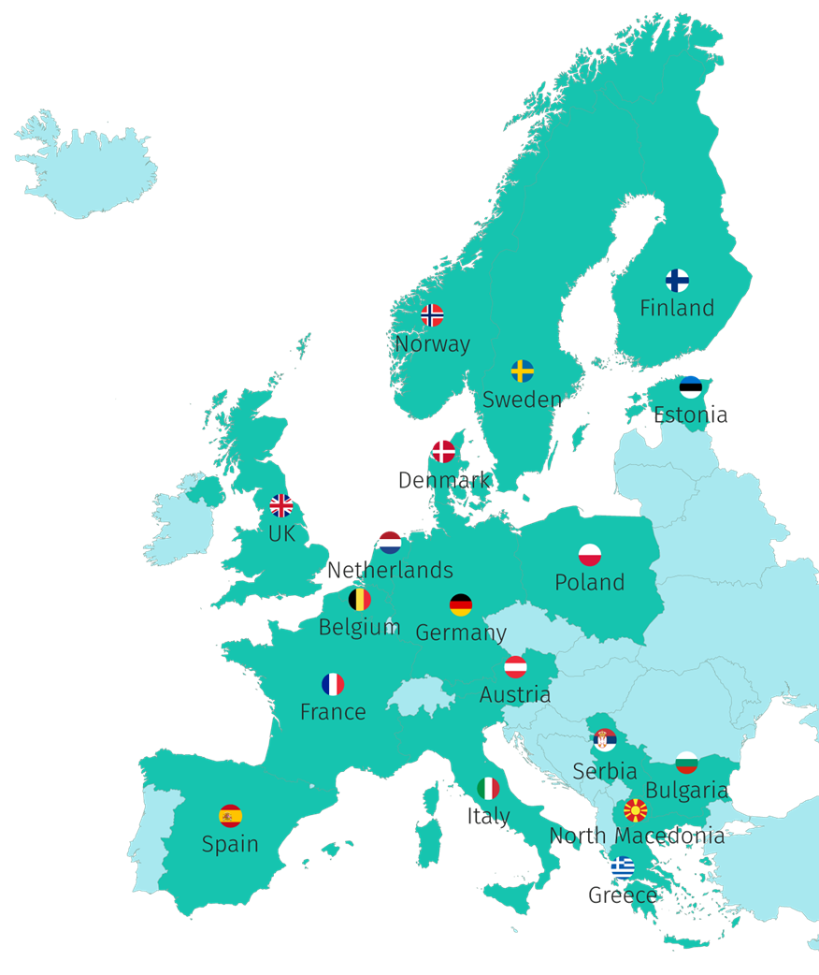






46 partners, 18 countries
“Key doers” in Open Science in their country/region/domain
2 ESFRI Research Infrastructure
6.6 million €
September 2022 - August 2025

Slide 3
Skills4EOSC Main Objective
Advance Open Science skills by unifying the current training landscape into a common and trusted pan-European ecosystem, closing the three gaps identified in the EOSC Strategic Research and Innovation Agenda 2021 in relation to Open Science competences:
lack of Open Science and data expertise,
lack of a clear definition of data professional profiles and corresponding career paths, and
fragmentation in training resources.

Slide 4





Skills&Training SRIA priorities and Skills4EOSC
SRIA Priorities
Skills4EOSC contribution
Priority 2: Bridging the education gap: coordinating and aligning curricula for students and researchers
Priority 1: Developing the next generation of Open Science and data professionals
Priority 4: Influencing national Open Science policy for skills by supporting strategic leaders
Skills4EOSC Network of Competence Centres
Minimum Viable Skillset defined for different roles acting in the OS context
Training of Trainers and FAIR by design methodology for learning materials
Supporting Professional Networks for lifelong learning
Target Science for Policy interface roles (policy makers,knowledge/honest brokers, civil servants)
Priority 3: Building a trusted and long-lasting knowledge hub of learning materials and related tools

Slide 5

c
Key Concepts
Competence Centre and network
Minimum Viable Skillset
FAIR-by-design methodology for learning material
Training of Trainers
Master trainer
Professional Networks
User Support Network
Co-Creation Mechanism

Slide 6
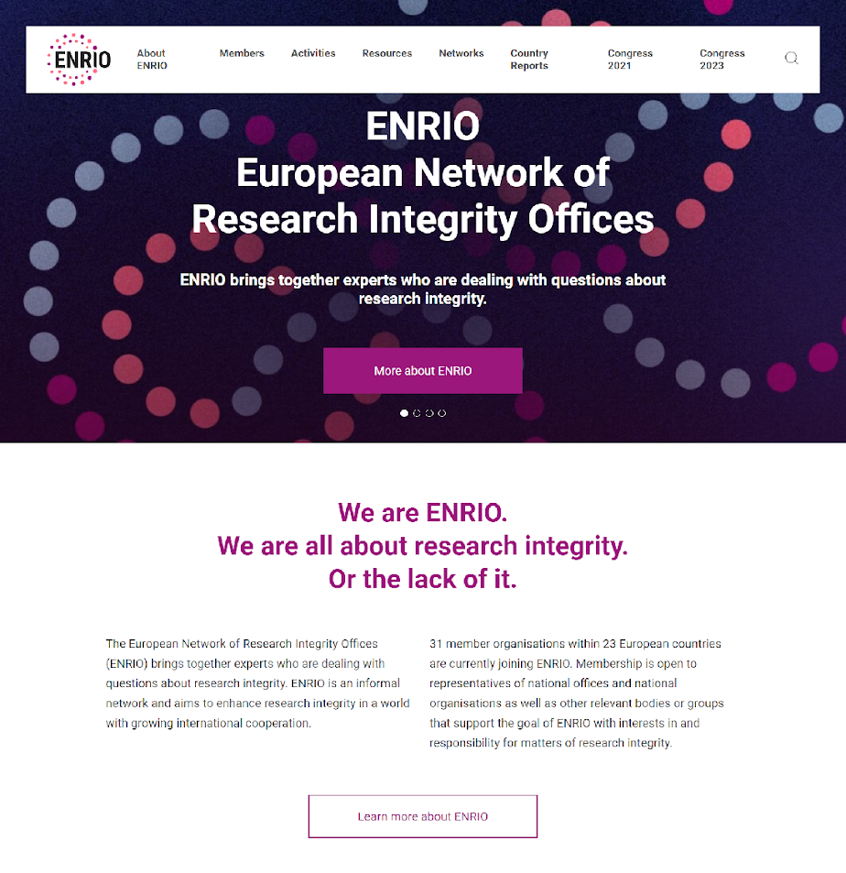
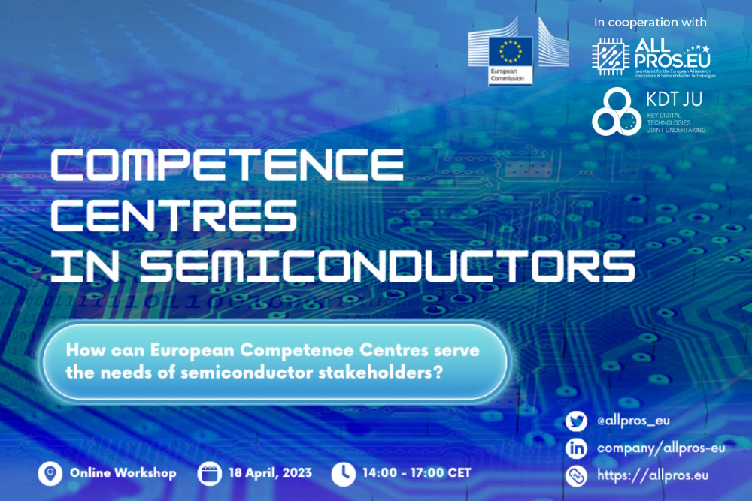
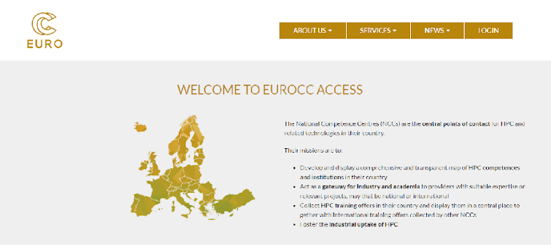

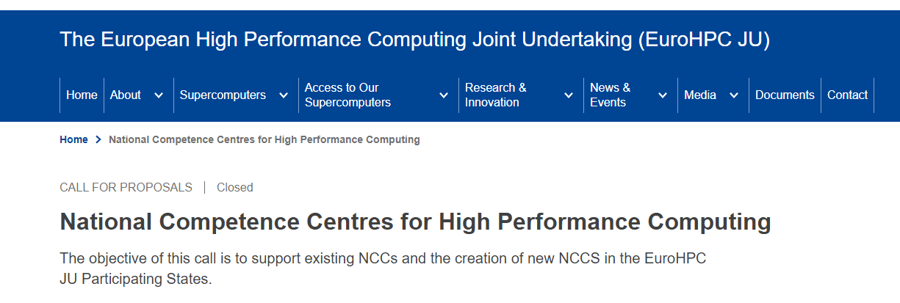
Competence Centres, we are not alone!
https://www.eurocc-access.eu/
http://www.enrio.eu/
https://allpros.eu/events/online-workshop-competence-centres-semiconductors
Silvana Muscella, et al. (2023). Bridging the Skills Shortage in the EU Semiconductor Industry. Zenodo. https://doi.org/10.5281/zenodo.8084984

Slide 7






Skills4EOSC Competence Centre
Skills4EOSC CC represent a point of reference in a specific Country/Region/Theme to find key competences to enable the practice of Open Science with adequate knowledge of standards, applications and tools and best practices for delivering, managing, re-using, sharing and analysing FAIR data, as well as other digital research objects.
Competences
People and Institutions
Services
Resources
Operational Tools
Notes:
The Skills4EOSC CC is dedicated to developing and sharing expertise in Open Science, FAIR, EOSC related fields.
It serves as a hub of knowledge and resources for the Country/Region/Domain, and its main goal is to improve the overall competency in the area covered by Skills4EOSC.
The Skills4EOSC CC includes a team of experts who possess in-depth knowledge and experience in the field of OS, FAIR and EOSC. They are responsible for conducting research, providing training and education, and advising other members of the organization on best practices and strategies.
The CC may also develop and maintain a repository of information, tools, and resources related to the area of expertise. This can include publications, white papers, case studies, and other materials that can be accessed by employees within the organization.
Overall, a competence plays a critical role in fostering a culture of continuous learning and improvement within an organization. By providing access to specialized knowledge and expertise, it can help the organization stay ahead of the curve in its chosen field and drive innovation and growth.

Slide 8

Link with local networks
Skills4EOSC Competence Centres can be built involving local members that are not part of the Consortium
Notes:
Foto di Clarisse Croset su Unsplash

Slide 9
Skills4EOSC methodology for competences harmonisation

Slide 10
Co-creation
Key project output undergo a two step co-creation process:
Consortium level
Community level
Relevant materials are uploaded in the Zenodo Community
Relevant stakeholders are invited to participate to the co-creation
A feedback survey/questionnaire is used to collect feedback from stakeholders
Dedicated webinars/events are organised to allow broader discussion

Slide 11





Competences Definition
Design learning paths & material
Training of Trainers delivery
Skills4EOSC defines a minimum set of competences for each target in the Minimum Viable Skillset
Through the FAIR by design methodology, learning materials for Training of Trainer programmes will be developed for various targets
Training of Trainers will be delivered to Competence Centres members to multiply the specific competences inside the Skills4EOSC Network.
Fall 2024

Slide 12
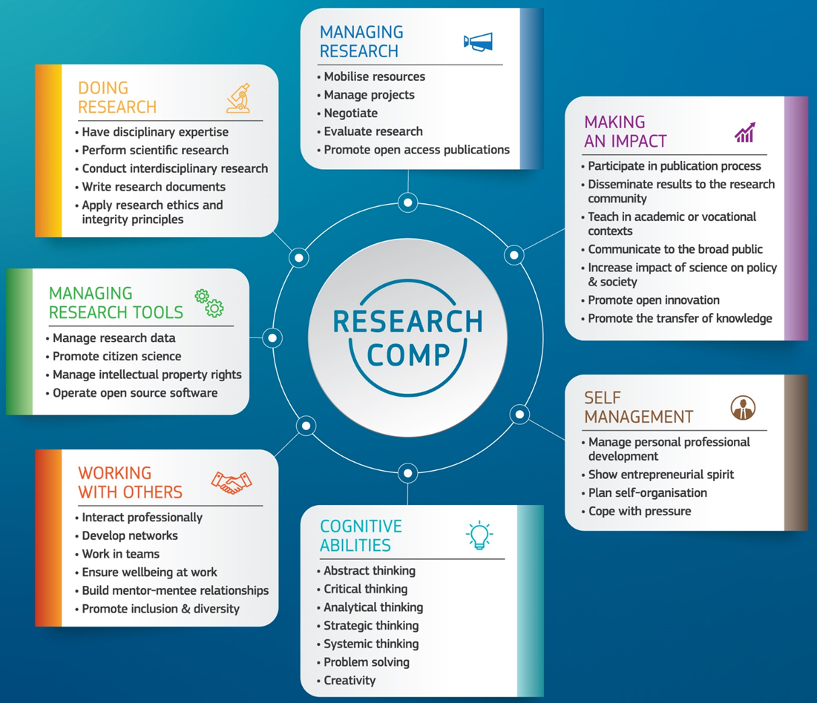

ResearchComp: the European Competence Framework for Researchers
7 Competence Areas
38 Competences
All competences are equally important & interrelated
Competences can be acquired via dedicated training, on-the-job-training, peer-to-peer learning, coaching and mentoring
Each stakeholder can use the Framework as a starting point to address its own needs
Researchers encouraged to develop competences in all 7 areas, but should not acquire the same or the highest level of proficiency for all competences

Slide 13
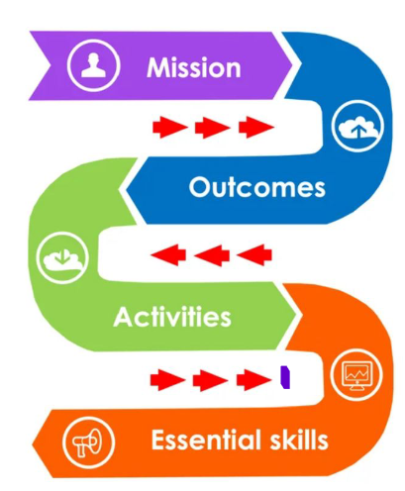
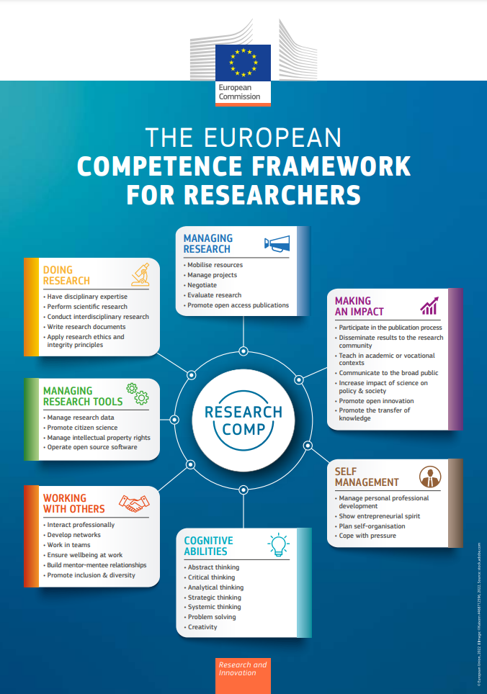
Minimum Viable Skillset - MVS
defining skills for different roles
The Minimum Viable Skillset profiles:
Address the skills needed for various EOSC actors considering the OS mission and planned outcomes
Address the need to summarise OS essentials
Provide high level guidance for curricula and trainings
Are adaptable to contexts/domains
Are intended to complement the European Competence Framework for Researchers
Whyte, A., et al. (2023). D2.1 Catalogue of Open Science Career Profiles - Minimum Viable Skillsets (v1.2). Zenodo. https://doi.org/10.5281/zenodo.8101903

Slide 14
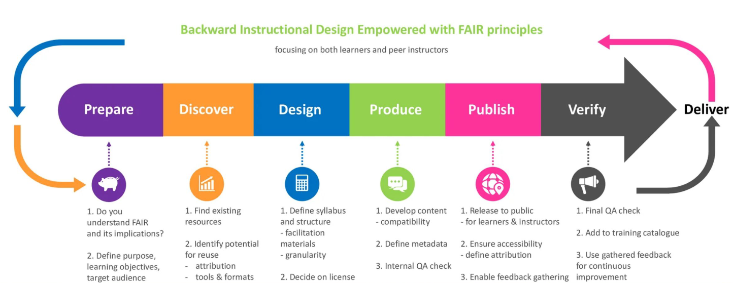
FAIR-by-design methodology
Filiposka, S., et al. (2023). Draft Methodology for FAIR-by-Design Learning Materials (1.2). Zenodo. https://doi.org/10.5281/zenodo.7875541 and Filiposka, S., et al. (2023). D2.2 Methodology for FAIR-by-Design Training Materials (1.4). Zenodo. https://doi.org/10.5281/zenodo.8305540

Slide 15
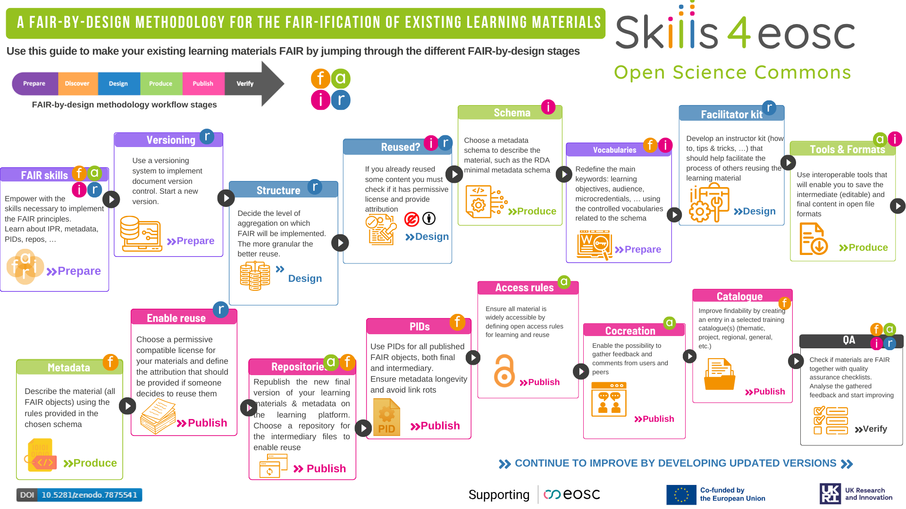
FAIR-by-design methodology
Filiposka, S., et al. (2023). Draft Methodology for FAIR-by-Design Learning Materials (1.2). Zenodo. https://doi.org/10.5281/zenodo.7875541 and Filiposka, S., et al. (2023). D2.2 Methodology for FAIR-by-Design Training Materials (1.4). Zenodo. https://doi.org/10.5281/zenodo.8305540

Slide 16
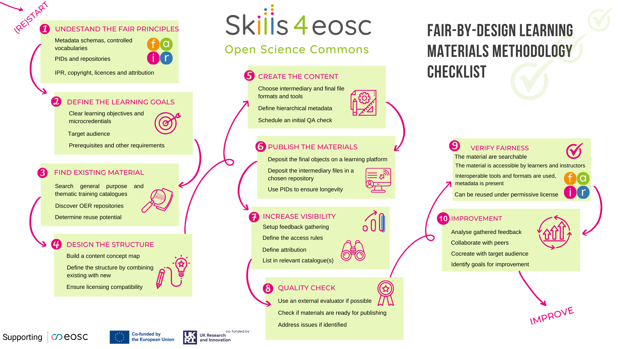
FAIR-by-design methodology
Filiposka, S., et al. (2023). Draft Methodology for FAIR-by-Design Learning Materials (1.2). Zenodo. https://doi.org/10.5281/zenodo.7875541 and Filiposka, S., et al. (2023). D2.2 Methodology for FAIR-by-Design Training Materials (1.4). Zenodo. https://doi.org/10.5281/zenodo.8305540

Slide 17
Skills4EOSC Quality assurance and Certification Framework

Slide 18
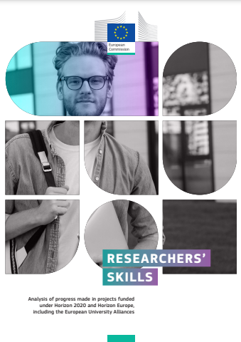
Skills4EOSC Recognition Framework
Skills4EOSC provides a collaborative, adaptable and inclusive framework, focusing on digital/data skills and using existing technologies for recognising competencies within the EOSC ecosystem.
A shared recognition framework that relies on common standards for skills recognition
The framework is flexible and scalable by adapting to emerging skills and evolving EOSC community needs and provides cross-border skills recognition.
The framework acknowledges a wide range of expertise and experiences and ensures inclusivity and diversity, also using digital tools like badges and verifiable credentials.
European Commission, European Research Executive Agency, Researchers' skills, Publications Office of the European Union, 2024, https://data.europa.eu/doi/10.2848/6977

Slide 19
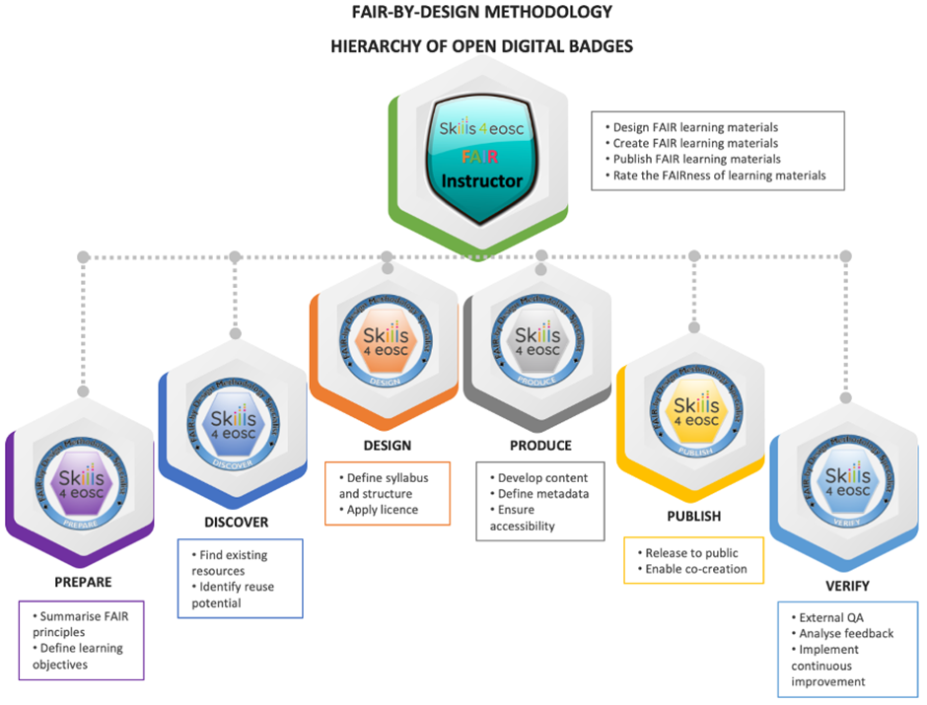
FAIR-by-design trainer accreditation
Structured into Six Stages. Each stage consists of specific units.
Stage-Specific Open Badge. Complete all units within a stage to earn a "FAIR-by-design Methodology Specialist" badge for that stage.
FAIR Instructor Badge. Earn all stage-specific badges to certify proficiency in methodology implementation and qualify as a FAIR instructional designer.

Slide 20


European Digital Credential - EDC
Skills4EOSC Recognition Framework will fit into the European Digital Credential for Learning
EC provides EDC, an online tool for getting or issuing a digitalised version of credentials.
EDCs are standardized electronic documents verifying skills or learning outcomes.
EDCs linked to Europass and can be issued by any European universities or training providers for free, securely sealed with an e-seal, and delivered via email or deposited to Europass profiles.

Slide 21
Quality Assurance Framework for learning materials
First Iteration published. Focus on Open Science professional training and qualifications
Reference Framework. It ensures quality of training materials and resources
Four key sub-frameworks:
Minimum Viable Skillset
FAIR-by-design
ELSI (Ethical, Legal, and Social Issues)
Evaluation framework and learning resources catalogues
Assessment of Training Materials. It defines attributes and questions for evaluation and it is applicable to Skills4EOSC and other Open Science resources
Methodology for Analysis. Designed essential elements, best practices, and evaluation frameworks and to initiate broader stakeholder discussion
Sánchez, M., Méndez, E., Whyte, A., Weisteen Bjerde, K., Martínez, S., Bueno, G., & Ucar, I. (2023). D2.3 Community-endorsed quality assurance and certification framework for professional training and qualifications (1.3). Zenodo. https://doi.org/10.5281/zenodo.8305482

Slide 22
Skills4EOSC Lifelong learning through peers

Slide 23
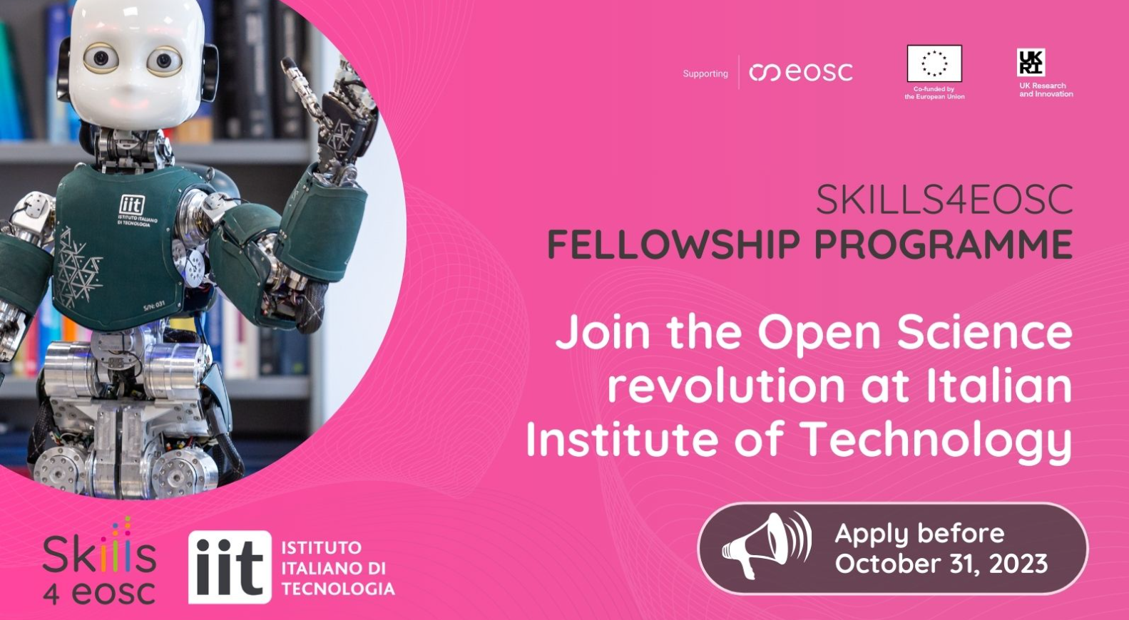
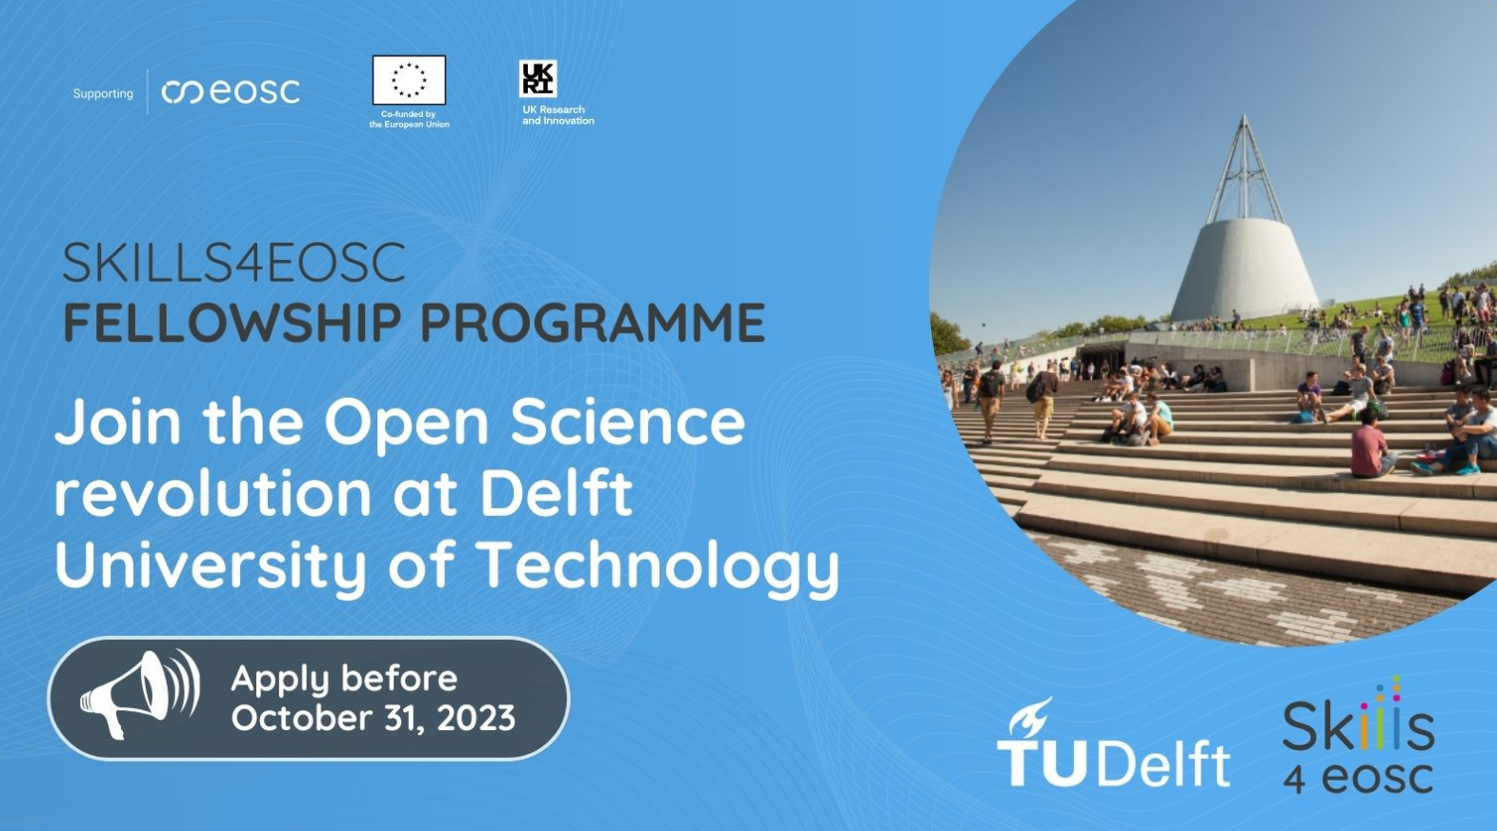
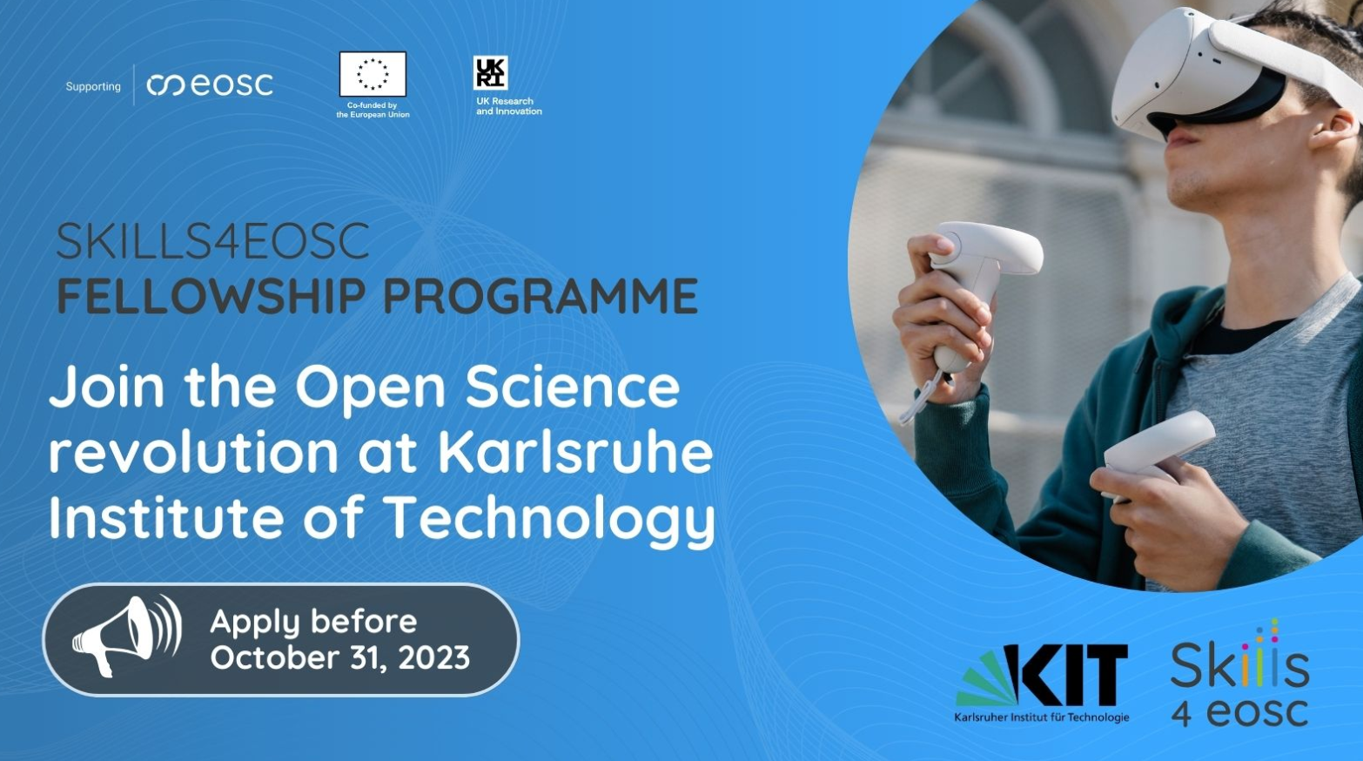
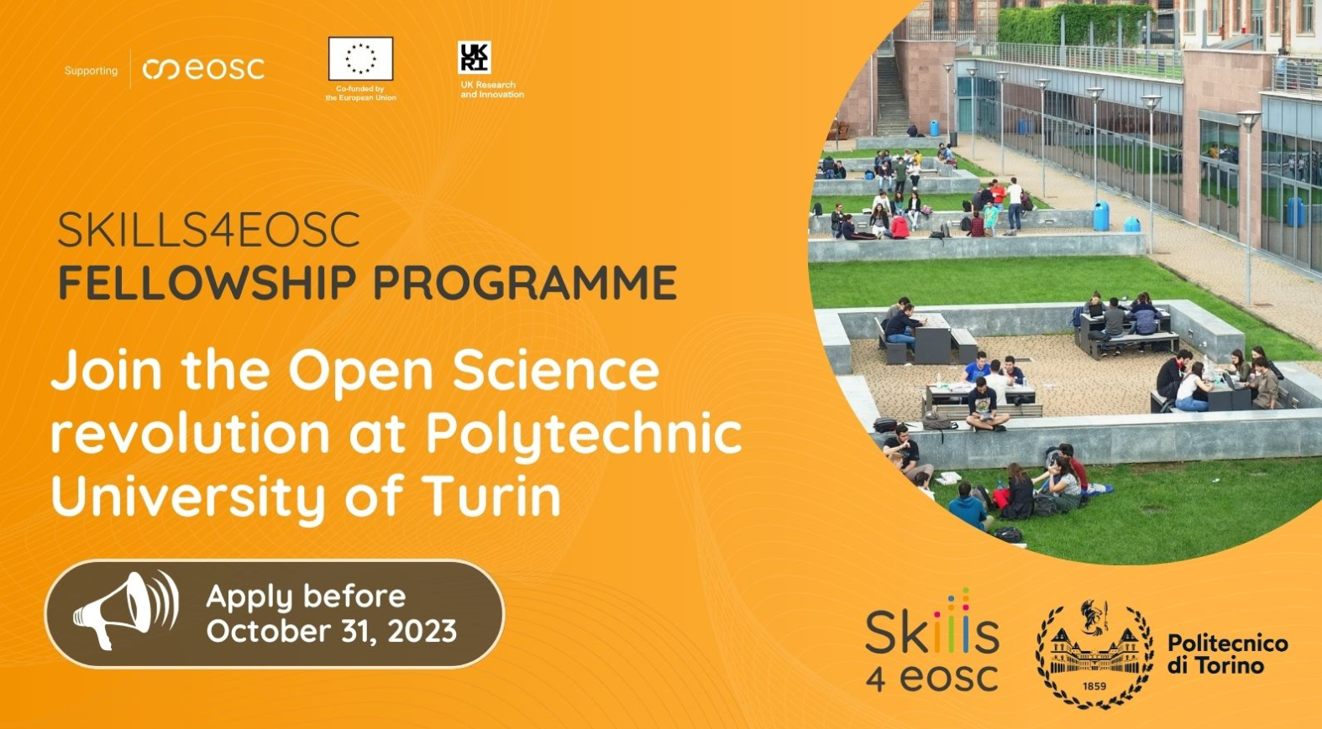
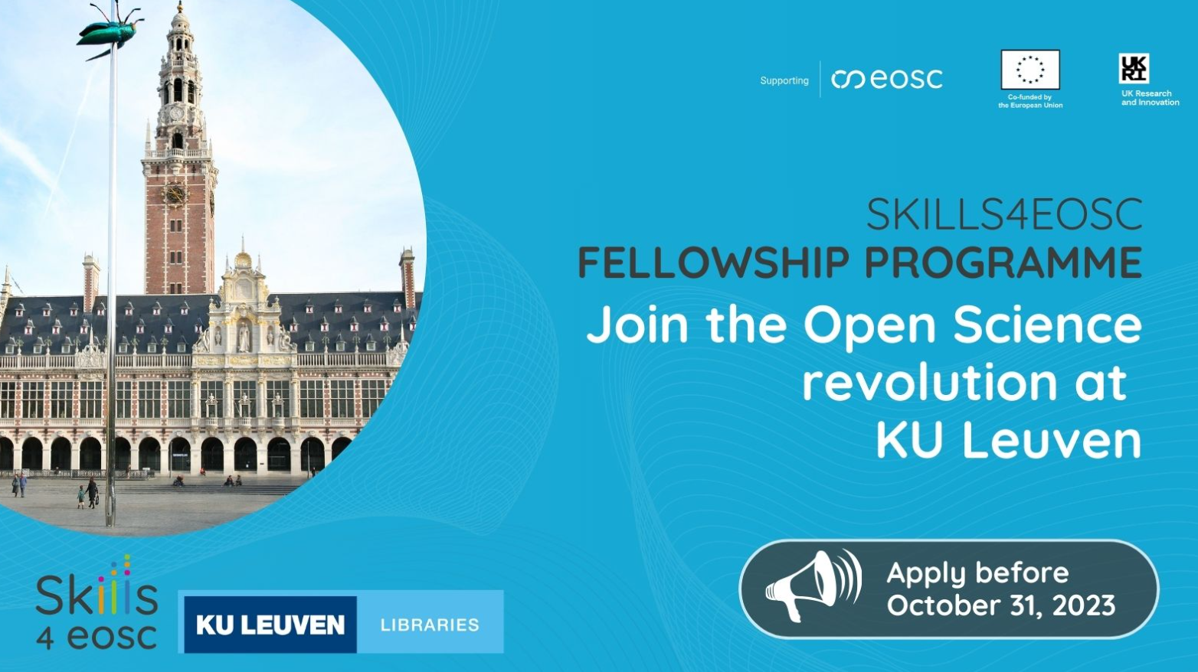
Fellowship Programme: unlocking opportunities in open science and FAIR data
Main objectives of the programme:
Support Life-Long Learning
Institutional Capacity Building
Knowledge Exchange
Strengthen Collaboration
A total of 9 fellowships were awarded by Skills4EOSC project
Notes:
Support Life-Long Learning: Encourage data professionals in Open Science to acquire skills relevant to Open and FAIR data practices and research data management, fostering continuous professional growth.
Institutional Capacity Building: Empower Fellows to build or consolidate Open and FAIR data practices within their home institutions, driving positive organisational change.
Knowledge Exchange: Enable Fellows to explore, establish, and share services, tools, and infrastructures related to Open and FAIR data.
Strengthen Collaboration: Facilitate collaboration among institutions by encouraging participation in relevant professional networks, creating a vibrant community of data professionals.

Slide 24

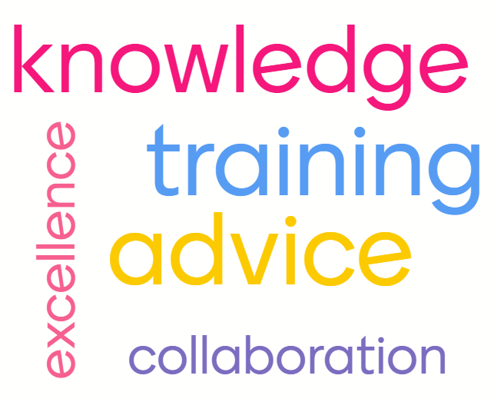
What do Competence Centres do?
Skills4EOSC CC are dedicated to knowledge organization and transfer in the Open Science, FAIR research output management and EOSC context.
They are associated with excellence, advice, training and knowledge transfer, and a collaborative approach of different institutions or departments.
Notes:
The Skills4EOSC CC is dedicated to developing and sharing expertise in Open Science, FAIR, EOSC related fields.
It serves as a hub of knowledge and resources for the Country/Region/Domain, and its main goal is to improve the overall competency in the area covered by Skills4EOSC.
The Skills4EOSC CC includes a team of experts who possess in-depth knowledge and experience in the field of OS, FAIR and EOSC. They are responsible for providing training and education, and advising the members of their community on best practices and strategies.
The CC may also develop and maintain a repository of information, tools, and resources related to the area of expertise. This can include publications, white papers, case studies, and other materials that can be accessed by employees within the organization.
Overall, a competence centre plays a critical role in fostering a culture of continuous learning and improvement within the context it operates in. By providing access to specialized knowledge and expertise, it can help the community stay ahead of the curve in its chosen field and drive innovation and growth.

Slide 25
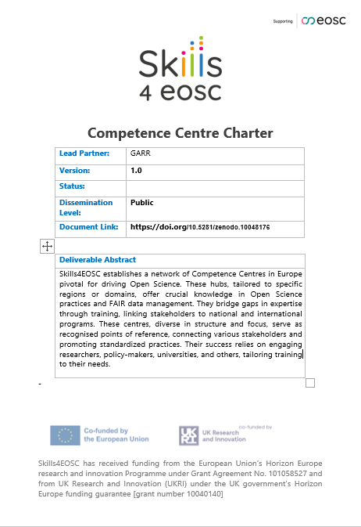
Skills4EOSC CC’s Charter
The Skills4EOSC CC represents a point of reference in a specific Region/Nation/Domain to find the key competences to enable practices of Open Science.
Skills4EOSC CCs are committed to adopting the project’s outcomes and assemble a proficient group of Master Trainers that will attend the ToT courses defined by the project.

Slide 26
Diversity and harmonisation
The structure, operational mode and organization of Skills4EOSC Competence Centres may vary very widely, depending on the Country, Region or Domain they operate in.
They constitute the nodes of the broader Skills4EOSC Coordination Network that ensures harmonisation and alignment at European level.
Harmonisation and Alignment
Coordination Network
Competence Centre
Diversity of the local level
Notes:
The structure, operational mode and organization of Skills4EOSC Competence Centres may vary very widely, depending on the Country, Region or Domain they operate in.
They constitute the nodes of the broader Skills4EOSC Coordination Network that ensures harmonisation and alignment at European level.

Slide 27


Competence centre Network
Competence centre Node
Competence centre Node
Professional Networks
User Support Network
Notes:
How are The Skills4EOSC Competence Centre nodes and network related to the Professional and User Support Networks?
User Support Network
Experts in specific fields/themes (eg: services, tools)
Mainly support users external to the network thanks to the expertise of its members
Exist independently of the Competence Centre
Professional Network
Groups of individuals who are connected through shared professional interests, goals, and values related to OS principles and practices (eg. Data Stewards, Librarians, Research Infrastructure professionists)
Local, regional, national, or international in scope
It is built to primarly support the member that compose the network (peers) through sharing of best practices and knowledge

Slide 28
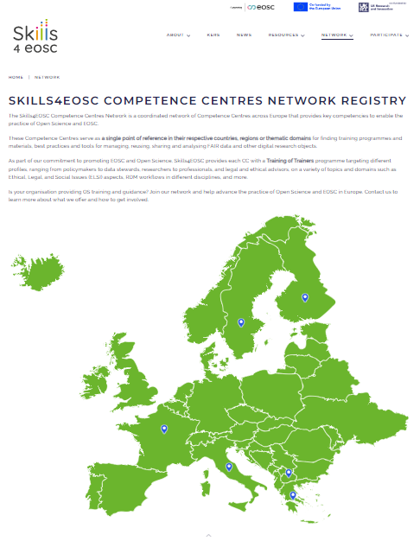
Skills4EOSC CCs Registry
The registry will be updated once the identified Competence Centres have attained an appropriate level of maturity and have joined Skills4EOSC by adopting the outcomes and participating in the Training of Trainers courses.

Slide 29
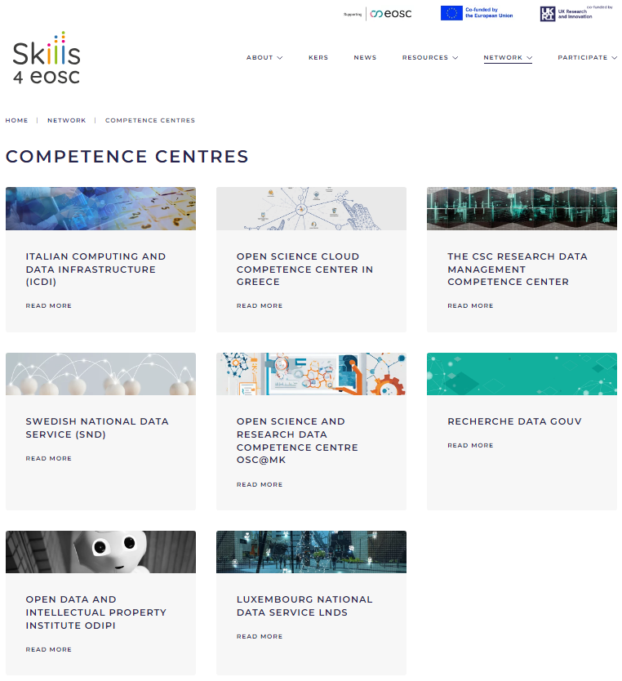
Skills4EOSC CCs Registry
Furthermore, ongoing discussion with:
Denmark: Danish e-Infrastructure Consortium (DeIC)
Germany: NFDI (National Research Data Infrastructure)
The Netherlands: Local Digital Competence Centres Network (LCRDM)
Norway: ongoing discussion led by HKDIR
Portugal Universidade do Minho
Slovenia: University of Ljubljana
Slovacchia; Slovak Centre of Scientific and Technical Information
Hungaria; KIFU (Kormányzati Informatikai Fejlesztési Ügynökség /Governmental Agency for IT Development)
Czech Republic: Czech EOSC Training Centre
Tunisia CNUDST Centre National Universitaire de Documentation Scientifique et Technique

Slide 30
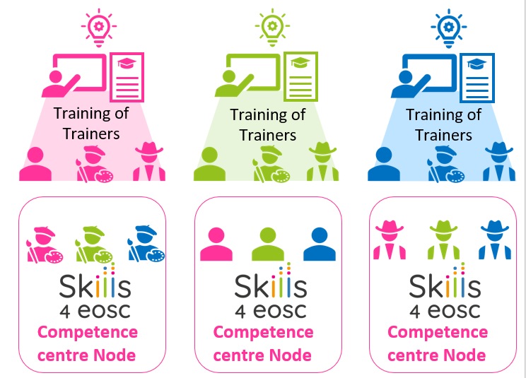
Training of Trainers Programme
Competence centre Network
Master Trainers are trained by the Skills4EOSC community through the Training of Trainers sessions.
After the Training of Trainers, the Master Trainers commit to sharing best practices and lessons learnt with their community trainers.
Notes:
Given a set of competences defined in a MVS for a given role, Training of Trainers and related FAIR by design learning material is designed by Skills4EOSC project.
One Master Trainer is selected from each Skills4EOSC Competence Centre.
Experts belonging to a Skills4EOSC Competence Centre.
Each Competence Centre should have at least one Master Trainer in each MVS related to a specific research role.
Master Trainers are trained by the Skills4EOSC community through the Training of Trainers (ToT) sessions.
After the ToT, the Master Trainers commit to sharing best practices and lessons learnt with their community trainers.
The process is replicated for each target role in the Skills4EOSC project.
For each role, a set of competences is defined in the MVS.
Training of Trainers is designed and delivered to Master Trainers belonging to the Competence Centre Nodes of the Skills4EOSC Network.
Experts belonging to a Skills4EOSC Competence Centre.
Each Competence Centre should have at least one Master Trainer in each MVS related to a specific research role.
Master Trainers are trained by the Skills4EOSC community through the Training of Trainers (ToT) sessions.
After the ToT, the Master Trainers commit to sharing best practices and lessons learnt with their community trainers.

Slide 31
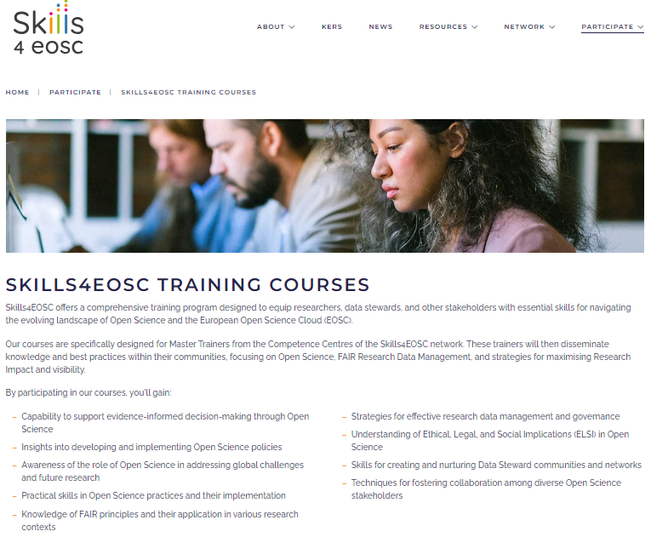
Training of Trainers Programme

Slide 32
Training of Trainers Programme
Title | Target | Topics
Science for policy | Policy makers, Civil servants, Researchers, | Open Science and Society, Open Science vs. Closed Science, Investing in Open Science, Capacity Building and Training Programs in OS
Learning path on ELSI | Researchers, Data Stewards and data professionals | Implications on research from ELSI , licenses, rights, ownership, tools and workflows, disciplinary differences, challenges and potentials
Open Science Course for Undergraduates | Undergraduate university students | Basic knowledge and skills needed in today's research environment - in their studies and futurTe careers.
Specialized Open Science Courses for Researchers in Social Sciences, Humanities, Solid Earth Science, Climate Change, and Museum Digital Collections | Researchers, PhD students, teachers | Scholarly communication outputs, FAIR and RDM aspects, use of tools and platforms, policies, opportunity of OS, standards
Open Science Communities Incubator | Data Steward Network Coordinators | This Starter Kit provides you the rationale, design, and guidelines to start your own local Open Science Community.
Notes:
The Skills4EOSC CC is dedicated to developing and sharing expertise in Open Science, FAIR, EOSC related fields.
It serves as a hub of knowledge and resources for the Country/Region/Domain, and its main goal is to improve the overall competency in the area covered by Skills4EOSC.
The Skills4EOSC CC includes a team of experts who possess in-depth knowledge and experience in the field of OS, FAIR and EOSC. They are responsible for conducting research, providing training and education, and advising other members of the organization on best practices and strategies.
The CC may also develop and maintain a repository of information, tools, and resources related to the area of expertise. This can include publications, white papers, case studies, and other materials that can be accessed by employees within the organization.
Overall, a competence center plays a critical role in fostering a culture of continuous learning and improvement within an organization. By providing access to specialized knowledge and expertise, it can help the organization stay ahead of the curve in its chosen field and drive innovation and growth.

Slide 33
Added values of the Network
Collaborative solutions and best practices
Development of harmonized and certified curricula for diverse Open Science roles
Accessible learning materials and training
Coordination and networking
Influencing National Open Science Policy

Slide 34

Skills4EOSC Competence Centre Network in presence Workshop October 21st, 2024 in presence, Berlin at the H4 Hotel Alexanderplatz open to all project participants and invited attendees

Slide 35

Unconference Session ‘Open Science Competence Centres in the EOSC and beyond’ organised jointly with OSCARS, EOSC Focus, EOSC-EuroScienceGateway, and EOSC Winter School OA5 group

Slide 36





Next steps
Starting from Autumn 2024 delivery of Training of Trainers activities |  | Continuous engagement with EOSC partnership and projects on Skills&Training activities |  | Selecting a set of interoperable IT services facilitating the CCs alignment
 | Strengthen Competence Centre network engaging with professionals and user support networks |  | Sustainability discussion involving relevant actors and EOSC partnership

Slide 37
Thank you! Questions?
Credit: The slides of this presentation were created by GARR (project coordinator of Skills4EOSC) Project coordinator office: coordinator@skills4eosc.eu Nana Anastasopoulou: nana@admin.grnet.gr Public launch of the Skills4EOSC Competence Centres network , 25 June 2024
Project coordinator office: coordinator@skills4eosc.eu

